Slide 1
Sustainable Management and Development for the Okavango Delta: Presentation Subtitle
Country Represented (Botswana, Angola, Namibia)
Group Members Names and Universities
Date

Slide 2
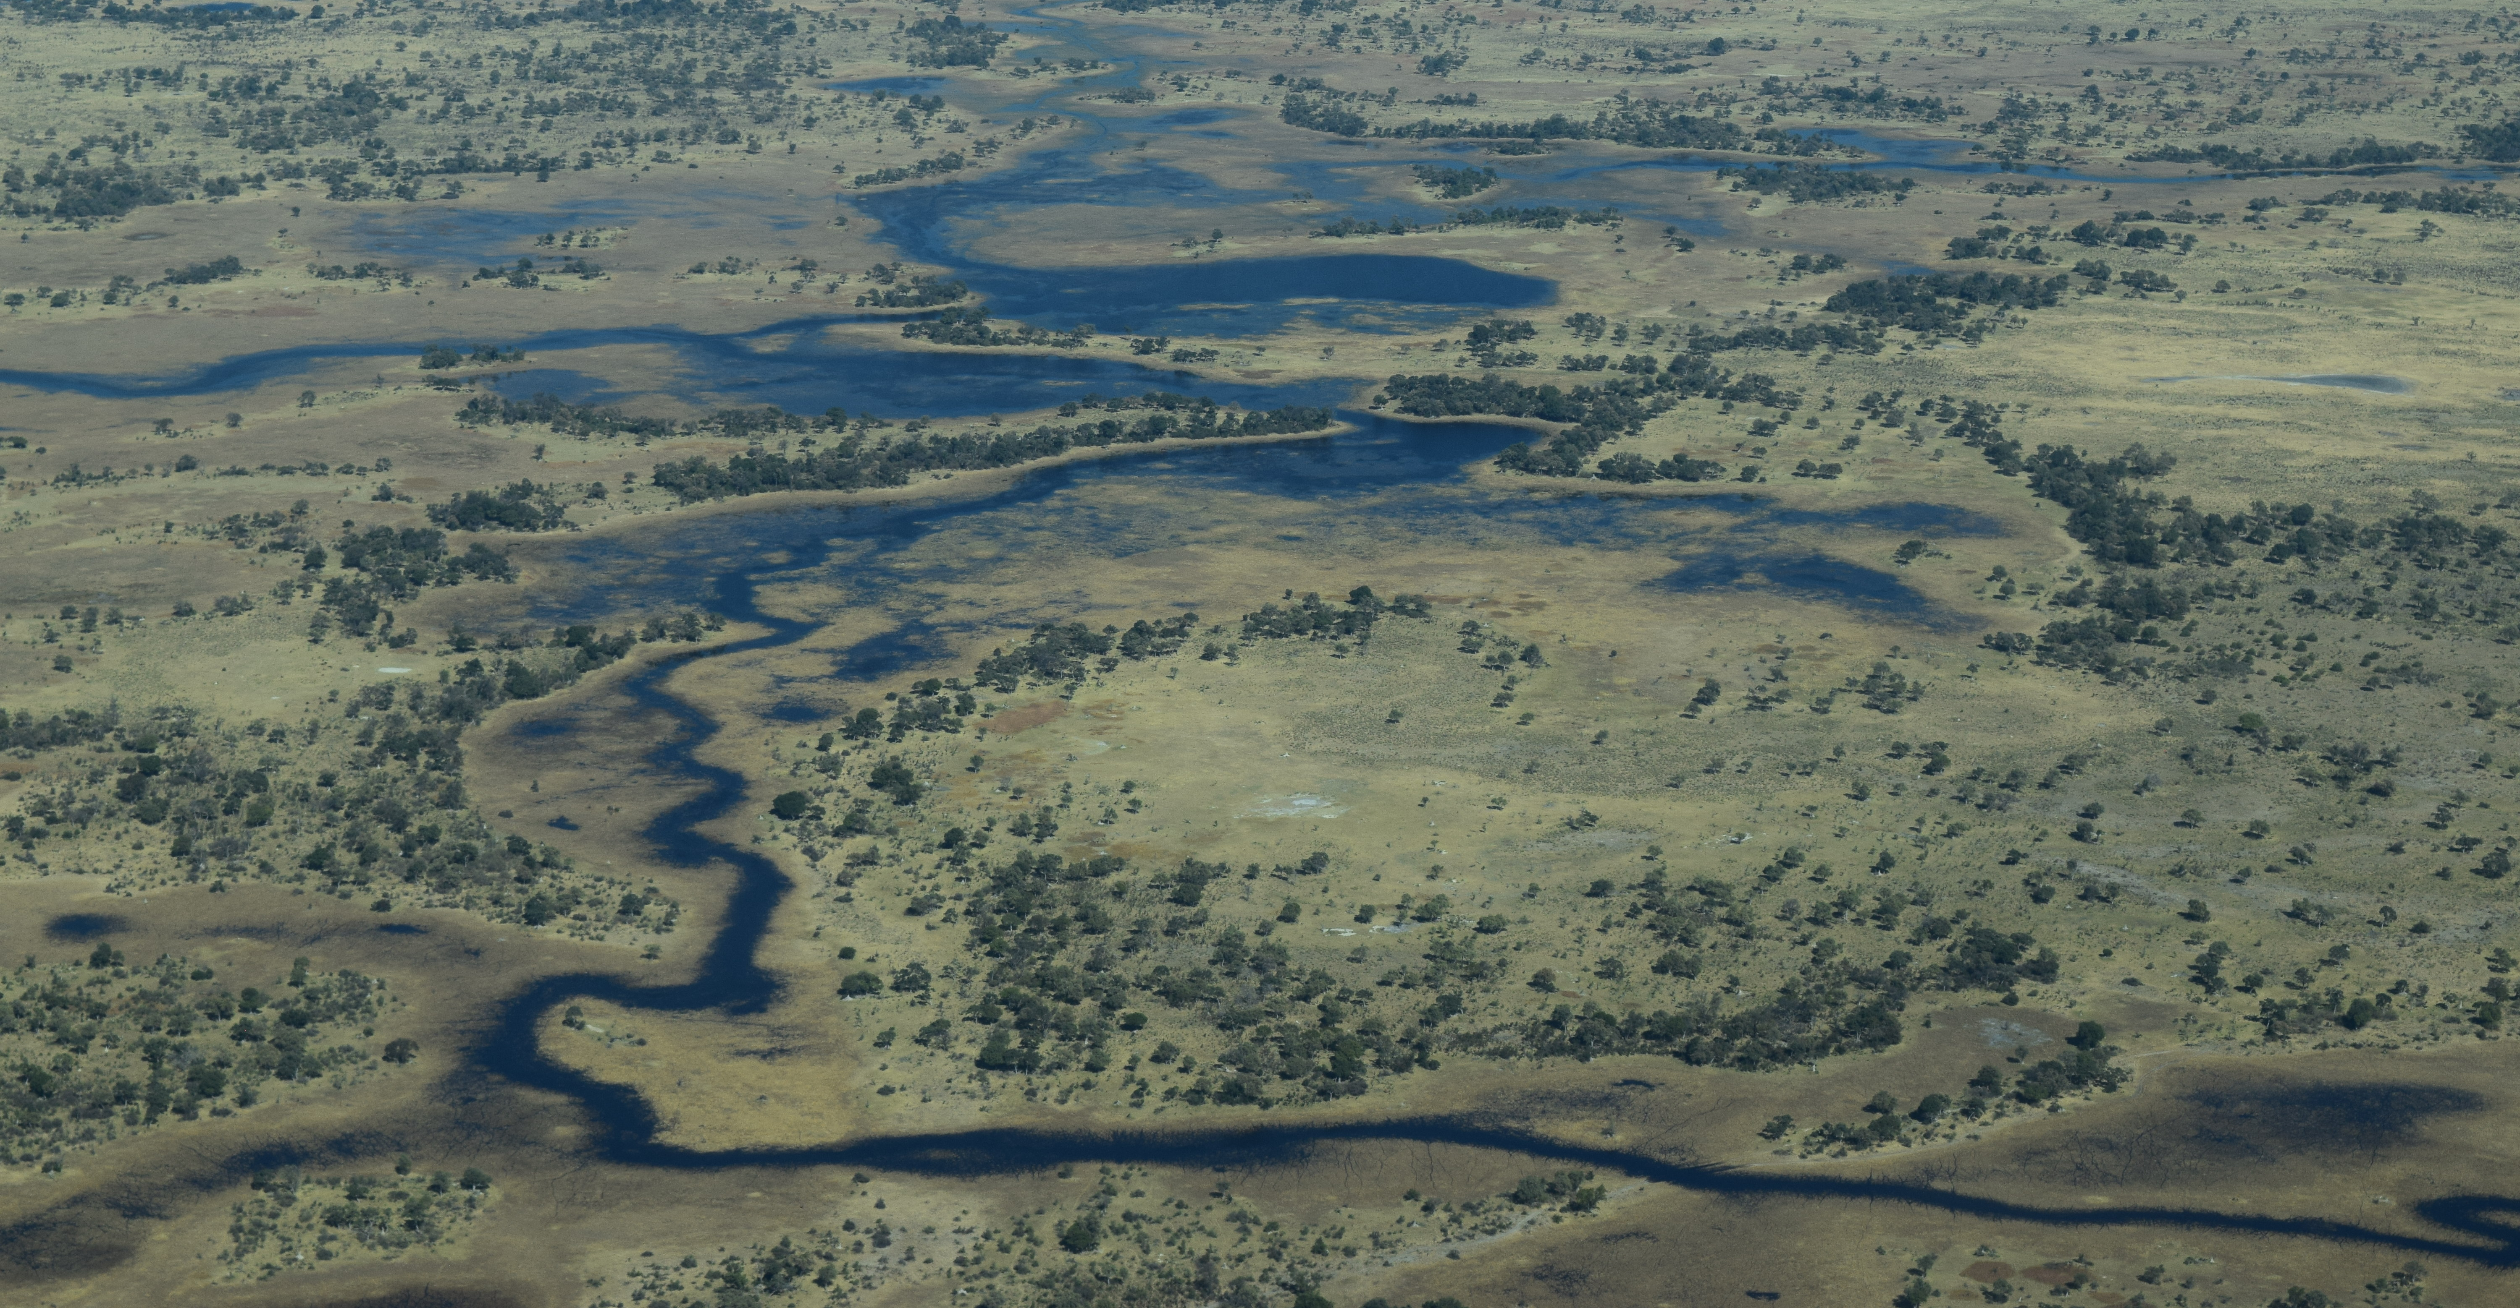
Introduction to the Okavango Delta

Slide 3
Introduction to the Okavango Delta
Geography, climate, hydrology
Importance to ecosystems and communities
Water management and governance regime

Slide 4
Country Context: Spotlight on (Botswana, Namibia, Angola)
Country-specific climate, geography, hydrology
Social, economic, cultural context
Current water use and development goals
Status on SDG 6 implementation

Slide 5
Sustainable Management and Development for the Okavango Delta
Strategy Title for (Botswana, Namibia, Angola)

Slide 6
Proposed Sustainable Development Strategy
3-5 key strategies for sustainable development for (Botswana, Namibia, Angola), within the broader context the Okavango Delta
Timeline for implementation

Slide 7
Ecological Impacts and Conservation Opportunities
For your sustainable management and development strategy, identify:
Anticipated effects on river systems, including flow regimes and aquatic systems
Anticipated effects on wildlife and habitats
Opportunities to achieve conservation goals
Proposed indicators and monitoring methods

Slide 8
Socioeconomic Impacts Assessment
For your sustainable management and evelopment strategy, identify:
Potential benefits and costs (including economic, social and cultural costs and benefits)
Equity and distribution of costs and benefits across
Consideration of vs. upstream and downstream effects

Slide 9
Stakeholder Identification & Analysis
For your sustainable management and development strategy, identify:
Key stakeholders across social and economic sectors
Key stakeholders across governance levels
Proposed approach for participatory engagement and collaborative governance within country and between countries
Note any special considerations for equity

Slide 10
Sustainable Management and Development Plan
Implementation for (proposed strategy)

Slide 11
Implementation Plan
Building upon the prior sections, identify 3-5 specific management actions to accomplish your overall strategy
Note any roadblocks, resource needs or alliances needed to implement your plan

Slide 12

Conclusion and Recommendations

Slide 13
Conclusion and Recommendations
Summary of your final recommendations
Call to action

Slide 14
Stakeholder Question & Answers

Slide 15



Holding Page for Executive Summary / Presentation Overview
Tbc last once final content is agreed
Note: all formatting (including colours and font size) to be edited/reviewed once text is agreed

